Slide 1

Analysis of Macroeconomic Variables on Bond Risk Premia
Group members: Chenghao Zhu, Haoyang Shang, Hanqing Zhang, Yiming Ding, Yufei Wang, Yuxuan Zhou

Slide 2
Contents
01
02
03
04
05
06
Introduction
Forward rate model and term structure model
Macroeconomic factors
New model
Trading Strategy
Conclusion

Slide 3

01
Introduction

Slide 4

Introduction
Forward interest rates can predict changes in interest rates and bond returns(Fama and Bliss)
Information on the term structure of interest rates can improve the ability to predict bond returns
Information on common macroeconomic variables may help improve the ability to predict bond returns
Notes:
The interest rate and the excess return rate in the bond market have always been important, and there are a large number of related theories and empirical analysis documents. Fama and Bliss conducted empirical research on the U.S. bond market and found that forward interest rates can predict changes in interest rates and bond returns. We found that: making full use of the information on the term structure of interest rates can improve the ability to predict bond returns; at the same time, in the US bond market, using information on some common macroeconomic variables cannot improve the ability to predict bond returns. This means that information on common macroeconomic variables has been fully reflected in the current term structure of interest rates.

Slide 5
02
Forward rate model and Term structure model

Slide 6
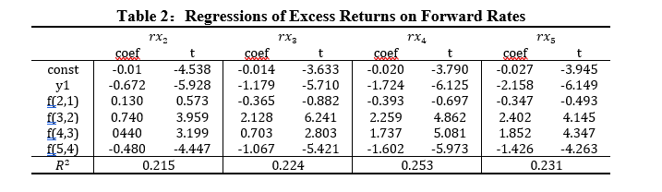
Forward rate model
Cochrane and Piazzesi find that a single factor which is named as the return-forecasting factor, predicts excess returns on one-year to five-year maturity bonds
We use the data from 1964 to 2003 to run regressions of excess returns on all forward rates

Slide 7
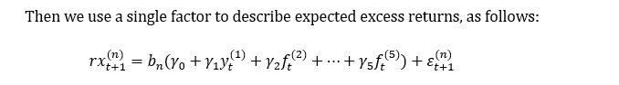
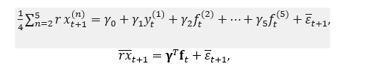
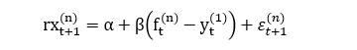
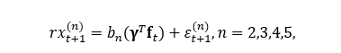
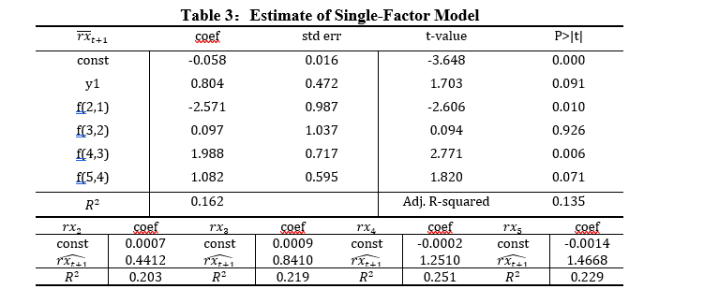
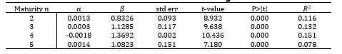
Then we use a single factor to describe expected excess returns
We also use the data to run Fama-Bliss Regressions
The Table shows the results of the above regressions
The Table shows the results of the above regressions

Slide 8
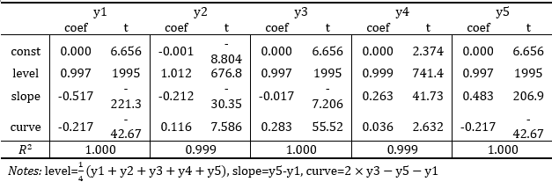
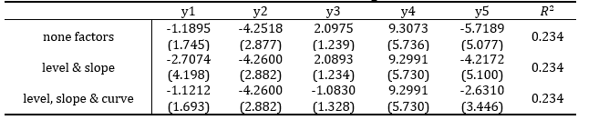
Term structure model
Cochrane and Piazzesi also proposed the yield curve factor according to Term structure models. They decomposed y to “level”, “slope” and “curvature” factors and connect return-forecasting factor to the yield curve
Estimate of Yield Factors
Excess Return Forecasts Using Yield Factors

Slide 9
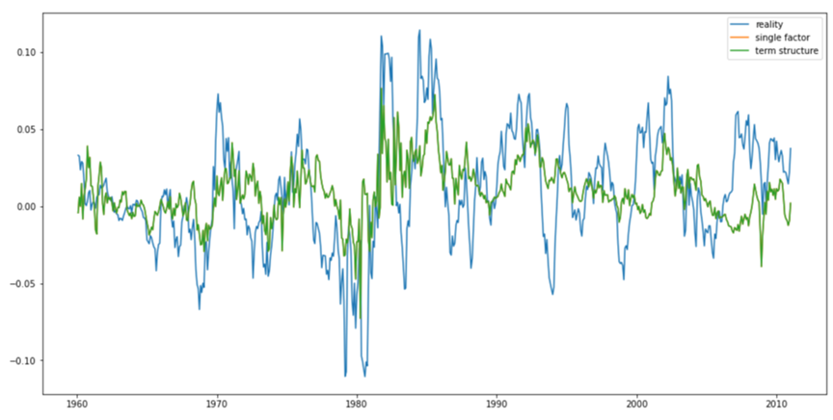
Return rate predictions of different models

Slide 10
03
Macroeconomic factors

Slide 11
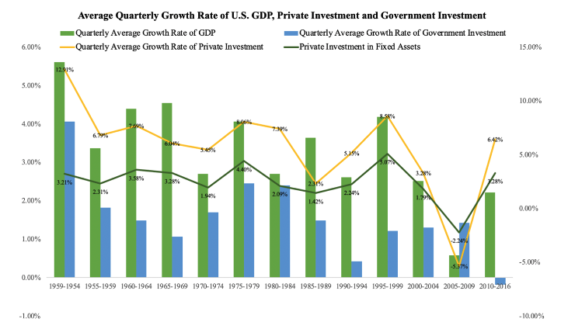
Visualization of US macro-economy factors
Despite the changes in methodology, certain macro economic factors remain essential

Slide 12
Incorporating Macroeconomic factors
DR : One-year deposit rate
M1, M2 : growth rate of monetary supply
I : growth rate of real investment
C : growth rate of real consumption
PPI : growth rate of the industrial goods
CPI : growth rate of the Consumer Price index
Monetary policy
Real economy
Inflation rate

Slide 13

04
New model
Where things get exciting

Slide 14
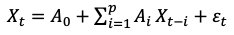
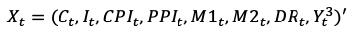
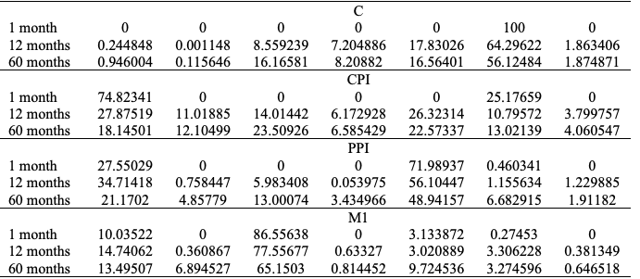
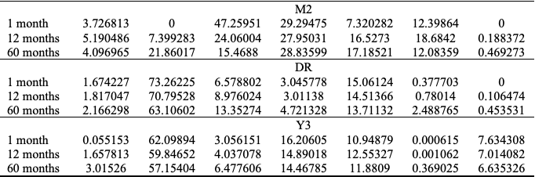
Correlation of them to market interest rate
Variance decomposition
Construct a vector autoregressive model
X is a vector of macroeconomic variables, monetary
policy variables, market interest rates (denoted by Yt)

Slide 15
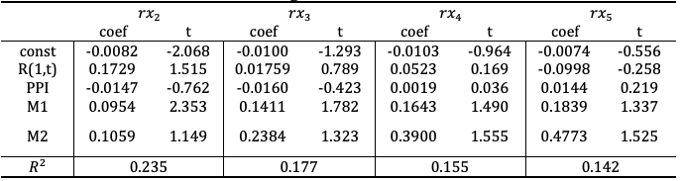
Empirical analysis of model
From variance decomposition, we regard these four factors as key reflections of economic state
DR :deposit rate
M1, M2 : growth rate of monetary supply
PPI : growth rate of the industrial goods
Due to the lag of publishment of macroeconomic data, a time lag of 2 months is used in the model
Regression summary
Not really satisfactory R-squared

Slide 16
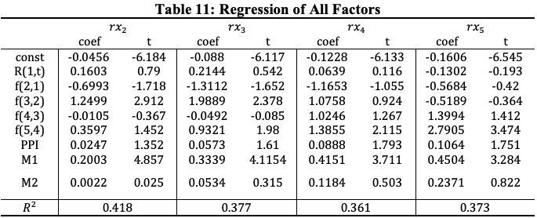
Combination of forward rate model with
macroeconomic factors
By extracting these four new variables and factored into the previous Fama Bliss model
We have more than doubled the R-square of the regression!

Slide 17
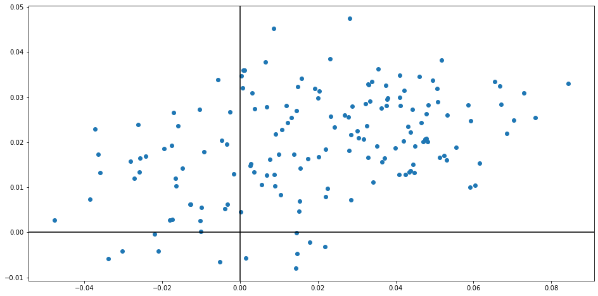
Forward Rate: Single Factor Signal VS Real Return

Slide 18
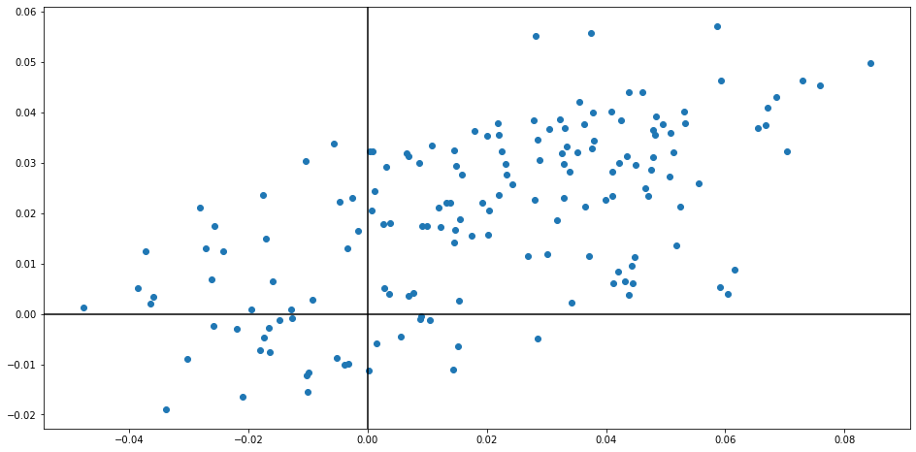
Macro Factors: Signal VS Real Return

Slide 19
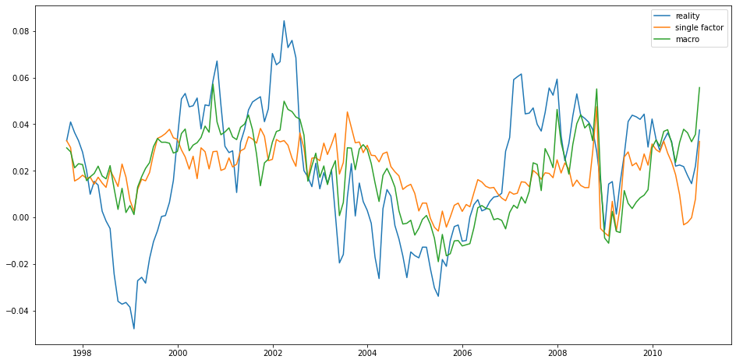
Simulated Return vs Real Return

Slide 20

05
Trading Strategy

Slide 21
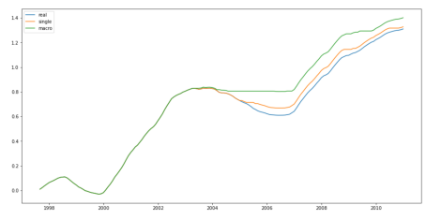
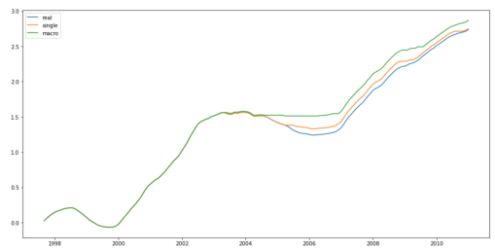
Simple strategy on different bonds
Two year bond
 | Annual return | Max drawdown | Sharpe ratio
Buy and hold | 10.02% | -19.85% | 2.14
Single | 10.16% | -14.98% | 2.22
Macro | 10.78% | -13.10% | 2.51
Three year bond
 | Annual return | Max drawdown | Sharpe ratio
Buy and hold | 21.73% | -27.90% | 2.37
Single | 21.86% | -24.18% | 2.42
Macro | 22.95% | -24.18% | 2.66

Slide 22

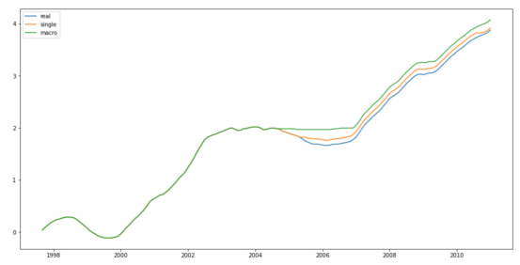
four year bond
 | Annual return | Max drawdown | Sharpe ratio
Real | 21.73% | -27.90% | 2.37
Single | 21.86% | -24.18% | 2.42
Macro | 22.95% | -24.18% | 2.66
Five year bond
 | Annual return | Max drawdown | Sharpe ratio
Real | 31.79% | -33.48% | 2.44
Single | 32.21% | -33.48% | 2.51
Macro | 33.83% | -33.48% | 2.72

Slide 23
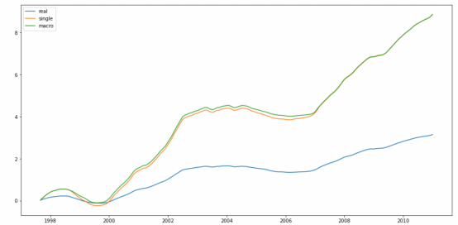
Alternative strategy
Combining with the result ,we discovered the optimal strategy: buy 2 bonds with highest predicted return
 | Annual return | Max drawdown | Sharpe ratio
Buy and hold | 25.32% | -29.26% | 2.40
Single | 84.61% | -56.01% | 2.66
Macro | 84.98% | -49.14% | 2.74
Final Sharpe Ratio: 2.74

Slide 24

06
Conclusion

Slide 25
Bond excess return is highly correlated with macro factors
Our new model shows great profitability

Slide 26


Slide 27

Thanks
for listening!

Slide 28
Reference
[1]Fama E, Bliss R. The information in the long-maturity rates[J].American Economic Review, 1987, 77(4):680-692.
[2] Cochrane J, Piazzesi M. Bond risk premia[J].The America Economic Review, 2005, 95 (1) :138—147.
[3] Sydney C. Ludvigson, Serena Ng. Macro Factors in Bond Risk Premia[J]. The Review of financial studies, 2009, 22(12):5027-5067.
[4] Jonathan H Wright. Term Premia and Inflation Uncertainty: Empirical Evidence from an International Panel Dataset[J]. American Economic Review,2011,101(4).
[5] Michael D. Bauer, Glenn D. Rudebusch, Jing Cynthia Wu. Term Premia and Inflation Uncertainty: Empirical Evidence from an International Panel Dataset: Comment[J]. American Economic Review,2014,104(1).
[6] Cieslak Anna, Povala Pavol. Expected Returns in Treasury Bonds[J]. Review of Financial Studies,2015,28(10).
[7] Hao Zhou. Variance Risk Premia, Asset Predictability Puzzles, and Macroeconomic Uncertainty[J]. Annual review of financial economics, 2018, 10:481-497.

